Slide 1
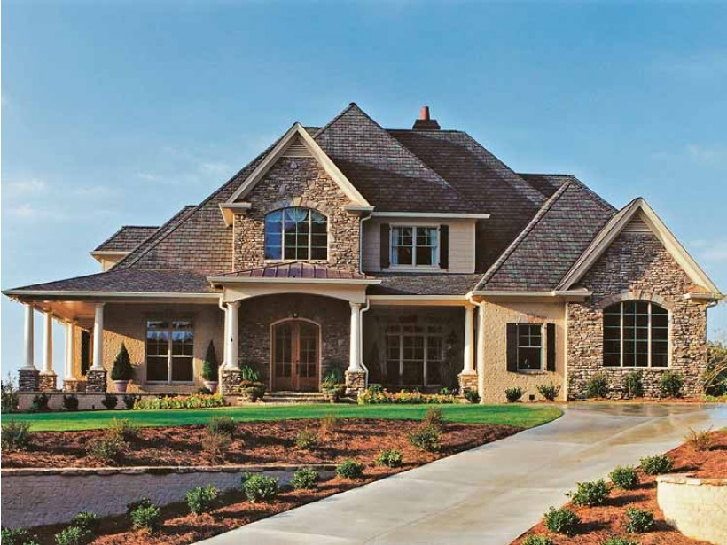
Data exploration techniques to determine house prices
By
SUSHAANTH SRIRANGAPATHI
SUDIPTI DEY
NIKITA SHROTE
LAKSHMI SRINIVASAN
KAUSHIK KOMPELLA
JAIDEEP ADUSUMELLI
ABHINAV SINGH

Slide 2
Problem Description
Ask a home buyer to describe their dream house, and they probably won't begin with the height of the basement ceiling or the proximity to an east-west railroad. But this playground competition's dataset proves that much more influences price negotiations than the number of bedrooms or a white-picket fence.
With 80 explanatory variables describing (almost) every aspect of residential homes in Ames, Iowa, the dataset challenges to predict the final price of each home.
This dataset lends itself to advanced regression techniques.

Slide 3
Objectives
To perform a data exploration on the dataset
Identify the relationship between the independent variables and dependent variable using correlation
Determine the relationship between the explanatory variables using multiple regression (Partial Correlation)
Feature engineer explanatory variables (PCA & results from correlation)
Subsidiary Analysis (Optional):
Predictive Modelling on the selected features
Analyze the performances of each model to select the best one

Slide 4
Approach
Data definition
Import the training and test dataset to the respective software
Understand the variables, their data types and values using the data dictionary
Missing Value and Outlier Treatment
Identify variables having more than a certain % of missing values and exclude them from the dataset
For the remaining variables, replace the missing values with mean, median or mode based on requirement
Uni and multi-variate Analysis
Plot a histogram for each of the independent variables and the dependent variable (Sales Price) and check the distribution for skewness and summary statistics (mean, median, mode and standard deviation)
Combining and transforming variables
Identify outliers for each variables and treat them based on requirements (exclude, cap or replace)
Plot scatter plots of independent variables against the dependent variable (Sales Price) to check for correlation and interaction amongst variables (multiple regression, partial correlation)
Try combining independent numeric/continuous variables of similar categories and check correlation with dependent variable again to see whether it helped in strengthening the relationship
Variable Selection
In this step, we try various methods for variable selection including correlation matrix plot, Random forest variable importance and PCAs
One can only try other feature selection methods such as forward/backward elimination or weight based feature optimization
Modelling
Run various iterations of the selected model techniques by changing the parameters and variable list each time to obtain best possible performance of the model
One can also try stacking various model iterations to help enhance the final model performance

Slide 5
Data definition, null value and outlier treatment
The dataset is divided into training and test both containing 1460 rows
There are a total of 81 variables- the dependent variable is named as Sales Price
The independent variables consist of metrics defining the property in terms of plot size, basement area, number of rooms, number of bathroom, type of alley outside house, car capacity of garage, neighborhood area of the property, etc
There were 4 variables which had more than 85% of null values and hence excluded from the dataset
Missing value treatment for continuous variables – replace with the median value
Missing value treatment for categorical variables- replace those values with the 'MIA'
Remove outliers using Median Absolute Deviation
Variable type | Count
Continuous | 35
Categorical | 46
Total | 81

Slide 6
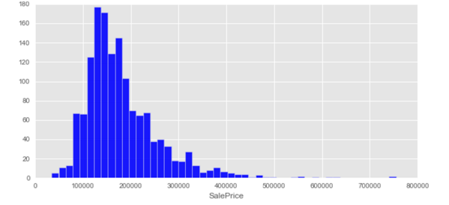
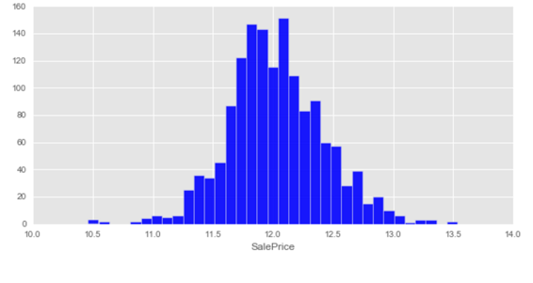
Univariate and Multi variate Analysis
The image on the left is the histogram plot of the dependent variable – SalesPrice.
We can see that the variable is left skewed and hence need to transform the variable
We use a logarithmic transformation on the variable to reduce the skewness which can be seen from the image on the right

Slide 7
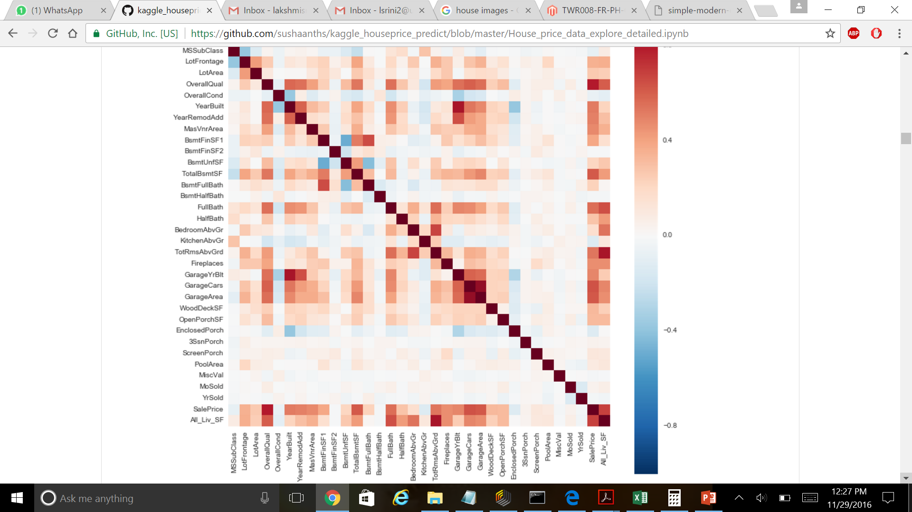
Univariate and Multi variate Analysis
The above image gives us a mosaic representation of correlation between 2 variables at a time
Squares with dark shades or red depict a strong positive relationship between two variables and squares with dark shades of blue depict a strong negative relationship between two variables
The squares with the dotted circles show the variables which have a strong relationship between them (positive or negative)

Slide 8
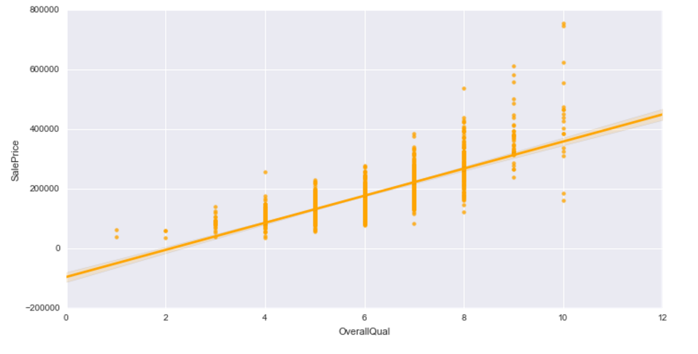
Regression plot of a categorical variable
Here is an example of a regression plot of a categorical variable (Overall quality) against the dependent variable (SalePrice)
The fitted line shows some relationship between Overall quality and Sales price (as the line is on an upward slope and not flat)
However we can see that there are very few data points lying in the category of overall quality between 8-12
As the Overall quality of the house increases, the sale price of the house increase (correlation not causation)

Slide 9
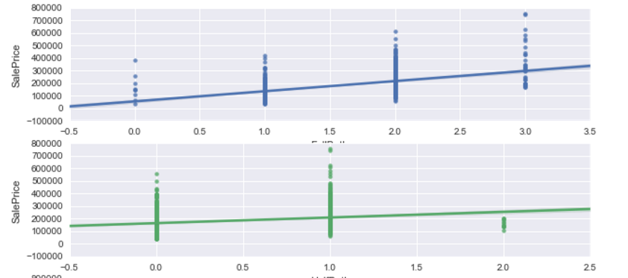
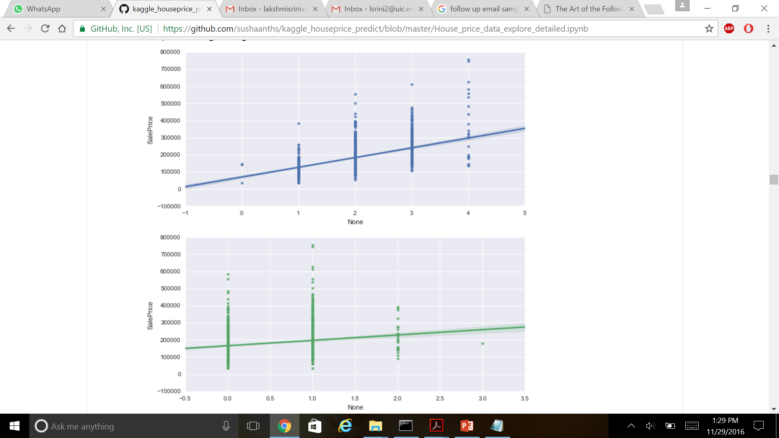
Variable transformation
We looked at two variables – number of full and half baths in the house individually against the dependent variable (sales price) and noticed that though there is some correlation between sales price and full bath or half bath, its not such a strong relationship (images on the left)
After combining the two variables as one (adding the values) and plotting it against Sales Price, we saw a stronger relationship between the new transformed variable and Sales Price

Slide 10
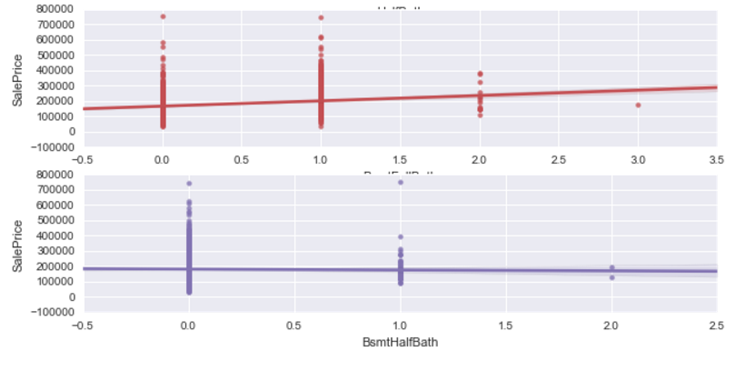
Variable transformation
We performed the same variable transformation on another set of two variables – Basement half bathrooms and basement full bathrooms
We observed an increase in the correlation between the two independent variables and sales price after they were combined as one

Slide 11
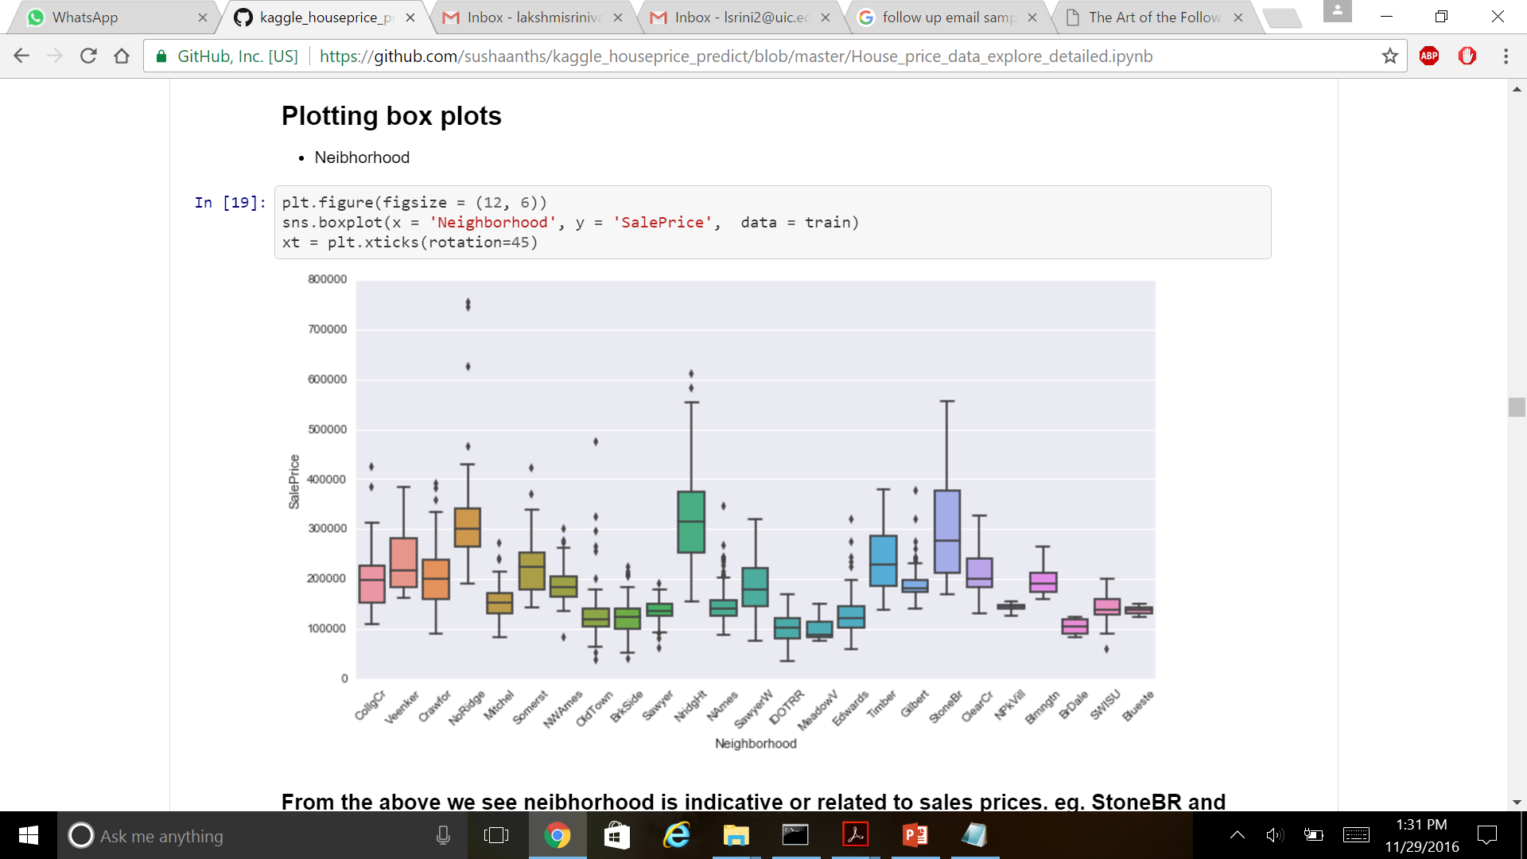
Variable transformation- categorical to binary (dummy variables)
One of the independent categorical variables named ‘Neighborhood’ had 25 categories
We plotted a box plot for each category of Neighborhood against the sales price to check which of the categories have a hiher median sales price - NridgHt and StoneBr (from the above image)
We transformed these 2 categories into binary variables (Eg- if data point( House ID) belongs to NridgHt then 1 else 0) as they have a relationship with the dependent variable

Slide 12
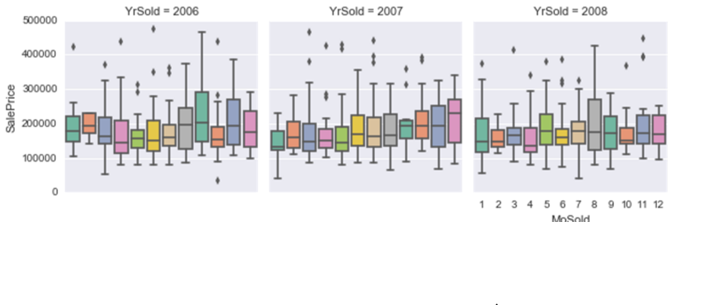
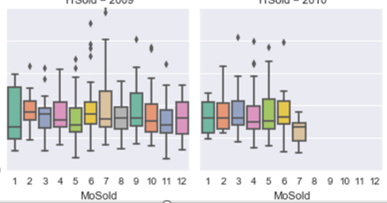
Is there a seasonality affect on Sales price?
YrSold = 2009
YrSold = 2010
Plotting box plots for each month of the year (2006 – 2010) against the Sales Price to see if there is a significant increase or decrease in Sale price during any particular months of the year
We can notice that there is no increase/decrease in Sales Price during any particular months across the years, hence there is no effect of seasonality on house sale prices

Slide 13
Data exploration Summary (intuitively)
Numeric Variables
1stFlrSF,2ndFlrSF,LowQualFinSF,GrLivArea are all skewed but influences house prices together. Hence we could group them to reduce dimensionality (All_Liv_SF)
OverallQual is a key indicator for the house prices
GarageCars and GarageArea have a positive relation with sales prices
YearBuilt and YearRemodAdd can provide some effect on sales price (not much)
Categorical Variables
neibhorhood is indicative or related to sales prices. eg. StoneBR and NridgHT have higher median price. We can group regions with similar prices into buckets to reduce dimension of this attribute
sales condition can be partial indicative of sales prices. eg. partial sales have higher house prices. Can be used
Sale's timing does not seem to hugely affect the house.
HouseStyle shows some indication of sales prices. But it doesnt provide enough info to be used all by itself like OveralQual
FireplaceQu actually determines the price. "Fireplaces" doesnt contribute much to the price compared to quality of the fireplace
CentralAir is a key indicator of price along with fireplace
KitchenQual is related to sales price of house
price is related to the MSZoning to some extent

Slide 14
Subsidiary Analysis & Results
Predictive modelling

Slide 15
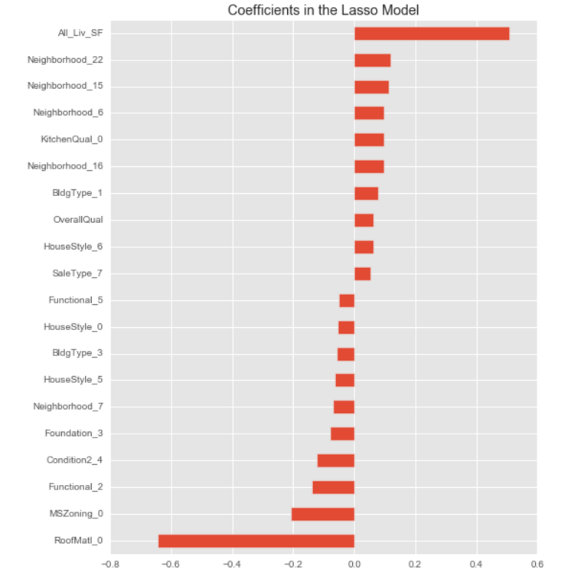
Variable importance plot (Lasso model)
The important exploratory variables identified through data exploration were considered important by the Lasso Regression model
There were few attributes which were identified as important by the model but it was not identified during exploration process
This emphasizes that using partial correlation will help us identify the more detailed insights

Slide 16
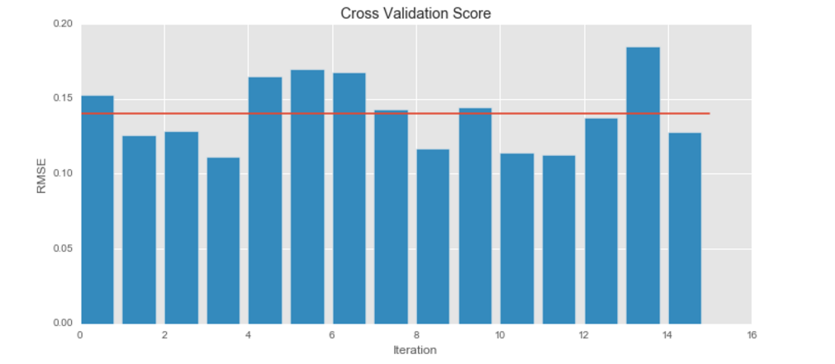
Modelling via Random Forest- Cross Validation Check
With out any transformation and specific variable selection we were able to obtain an RMSE score of 0.140 (Rank 1120 in kaggle)

Slide 17
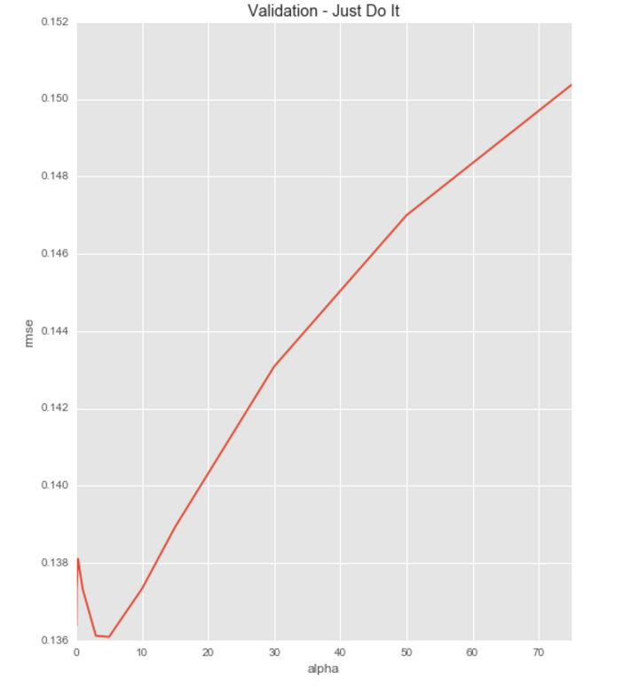
Modelling via Lasso Regression
MSE
After the transformation process and proper feature selection we were able to obtain MSE of 0.136 (Rank 712 in kaggle)

Slide 18
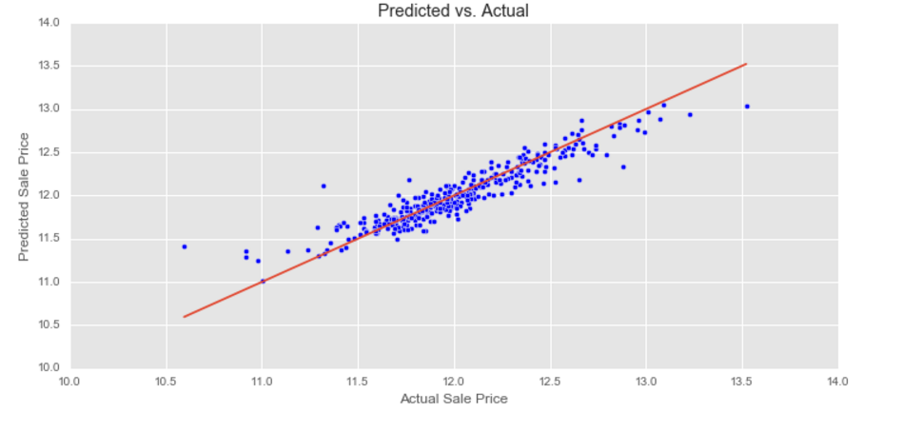
Predicted vs Actual Sales Price
The above plot shows the goodness of fit line for the Lasso model.
We can observe that there are many data points away from the line (high residuals) which shows that this model may not be the best
Requires more feature engineering to be performed to get a better goodness of fit

Slide 19
Sources
Git link https://github.com/sushaanths/kaggle_houseprice_predict/blob/master/model%20fitting.ipynb
Kaggle Dataset
https://www.kaggle.com/c/house-prices-advanced-regression-techniques
Exploratory data analysis https://en.wikipedia.org/wiki/Exploratory_data_analysis
Partial correlation https://en.wikipedia.org/wiki/Partial_correlation
Correlation matrix in R http://www.sthda.com/english/wiki/correlation-matrix-a-quick-start-guide-to-analyze-format-and-visualize-a-correlation-matrix-using-r-software

Slide 20


